Slide 1
Other Filters
스마트자동차학과
박성근(keiny@sch.ac.kr)

Slide 2
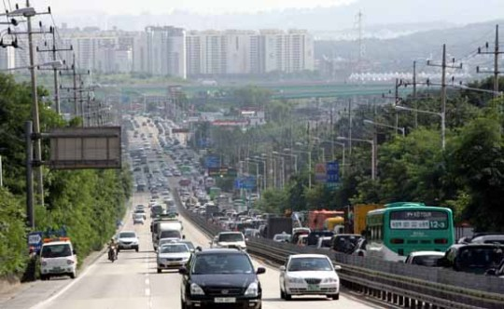
Real Road Situation

Slide 3
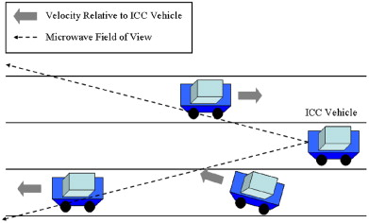
Interacting Multiple Model

Slide 4
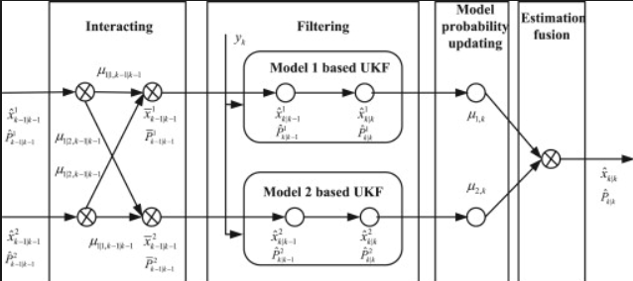
Interacting Multiple Model

Slide 5
Interacting Multiple Model
In general Moving case,
If vehicle(or target) is maneuvering,

Slide 6
Interacting Multiple Model

Slide 7
Interacting Multiple Model

Slide 8
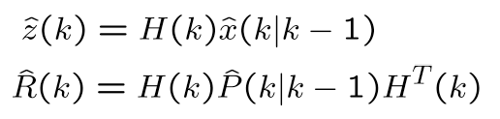
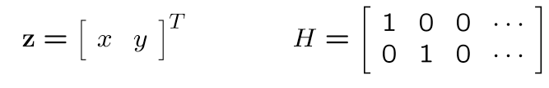
Similarity(Validation Gate)
Measurement and measurement cov. prediction
This is typically a frame transformation into sensor space
If only the position of the target is observed (typical case), the measurement matrix is

Slide 9
Similarity(Validation Gate)
Then, the measurements will be in the area
with a probability defined by the gate threshold
(omitting indices k)

Slide 10
Similarity(Validation Gate)
The shape of the validation gate is a hyper-ellipsoid
This follows from setting
leading to
which describes a conic section in matrix form
▪ The gate is a iso-probability contour obtained
when intersecting a Gaussian with a hyper-plane.

Slide 11
Similarity(Validation Gate)

Slide 12
Similarity(Validation Gate)

Slide 13
Similarity(Validation Gate)

Slide 14
Interacting Multiple Model

Slide 15
Interacting Multiple Model

Slide 16
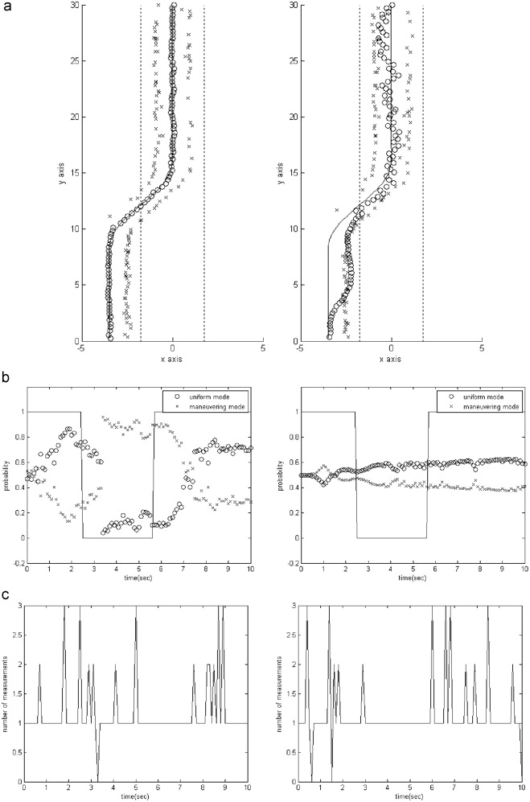
Interacting Multiple Model

Slide 17
Interacting Multiple Model

Slide 18
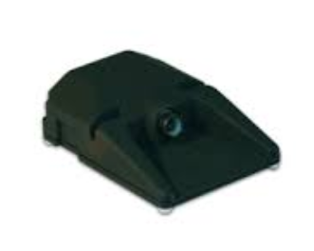
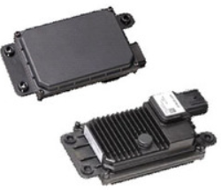
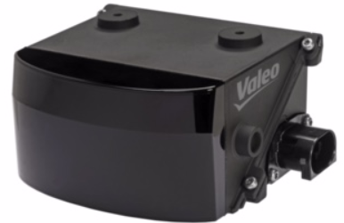
Data Association
In real world System, Kalman filter(or its variation) is enough to find out the exact information of target?

Slide 19
Data Association
What is data association?
“Data association is the process of associating uncertain measurements to known tracks.”
This problem encompasses a number of related issues:
- Track creation, maintenance, and deletion
- Single or multiple sensors
- Target detection
- False alarm model and rates
- Single or multiple targets

Slide 20
Data Association
How close it is?
Target
Which one makes sense?
Measurement

Slide 21
Data Association
Overall procedure:
▪ Make observations (= measurements).
Measurements can be raw data (e.g. processed radar signals) or the output of some target detector (e.g. people detector)
▪ Predict the measurements from the predicted tracks. This yields an area in sensor space where to expect an observation. The area is called validation gate and is used to narrow the search
▪ Check if a measurement lies in the gate.
If yes, then it is a valid candidate for a pairing/match

Slide 22
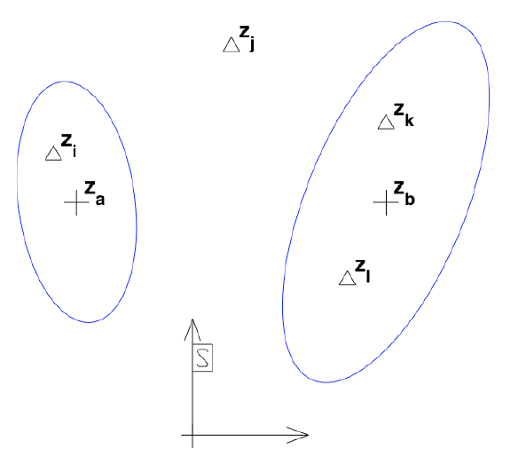
Data Association
What makes this a difficult problem
▪ Multiple targets
▪ False alarms
▪ Detection uncertainty
(occlusions, sensor
failures, …)
▪ Ambiguities
(several measurements
in the gate)

Slide 23
Measurement Prediction
Measurement and measurement cov. prediction
This is typically a frame transformation into sensor space
If only the position of the target is observed (typical case), the measurement matrix is
Note: One can also observe
Velocity (Doppler radar)
Acceleration (accelerometers)

Slide 24
Validation Gate
Then, the measurements will be in the area
with a probability defined by the gate threshold
(omitting indices k)

Slide 25
Validation Gate
The shape of the validation gate is a hyper-ellipsoid
This follows from setting
leading to
which describes a conic section in matrix form
▪ The gate is a iso-probability contour obtained
when intersecting a Gaussian with a hyper-plane.

Slide 26
Validation Gate : Euclidian Distance

Slide 27
Validation Gate : Mahalanobis Distance

Slide 28
Validation Gate : Mahalanobis Distance

Slide 29
False Alarms

Slide 30
False Alarm Model

Slide 31
False Alarm Model

Slide 32
Single Target Data Association

Slide 33
Single Target DA: NNSF
Nearest Neighbor Standard Filter (NNSF)
1. Compute Mahalanobis distance to all measurements
2. Accept the closest measurement
3. Update the track as if it were the correct one
Problem: with some probability the selected measurement
is not the correct one. This can lead to overconfident
covariances, filter divergence and track loss. Covariances
will collapse in any case.
Conservative NNSF variant:
- Do not associate in case of ambiguities
- Other variant: Strongest Neighbor Standard filter:
- Used, e.g., with sonar sensors

Slide 34
Single Target DA: PDAF

Slide 35
Single Target DA: PDAF

Slide 36
Single Target DA: PDAF

Slide 37
Single Target DA

Slide 38
Single Target DA

Slide 39
Multi-Target Data Association

Slide 40
Multi-Target DA : NNSF

Slide 41
Multi-Target DA: Global NNSF

Slide 42
Multi-Target DA: Global NNSF

Slide 43
Multi-Target DA: Global NNSF

Slide 44
Multi-Target DA: MHT

Slide 45
MHT: Hypothesis Generation

Slide 46
MHT: Hypothesis Generation

Slide 47
MHT: Hypothesis Generation

Slide 48
MHT: Hypothesis Generation

Slide 49
MHT: Hypothesis Generation

Slide 50
MHT: Hypothesis Evaluation

Slide 51
MHT: Hypothesis Evaluation

Slide 52
MHT: Hypothesis Evaluation

Slide 53
MHT: Hypothesis Evaluation

Slide 54
MHT: Hypothesis Evaluation

Slide 55
MHT: Hypothesis Evaluation

Slide 56
MHT: Hypothesis Evaluation

Slide 57
MHT: Hypothesis Evaluation

Slide 58
MHT: Hypothesis Evaluation

Slide 59
MHT: Hypothesis Evaluation

Slide 60
MHT: Hypothesis Evaluation

Slide 61
Multi-Target DA: Summary

